Slide 1




AUTOMATED CCTV CAMERAS MONITORING USING IMAGE CAPTIONING
Submitted By- Prabhu Prasad Mohanty
Mentor- Sudheer Kumar Yedunuri

Slide 2
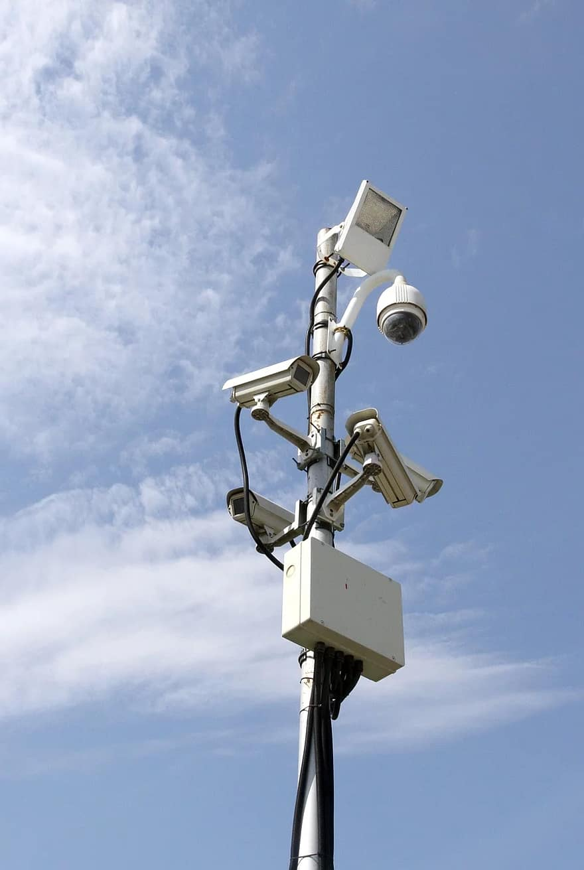
CONTENTS
Problem Statement
Business Use Cases
Dataset and Data Preprocessing
Modeling Approach
Modeling Results & Future Scope

Slide 3
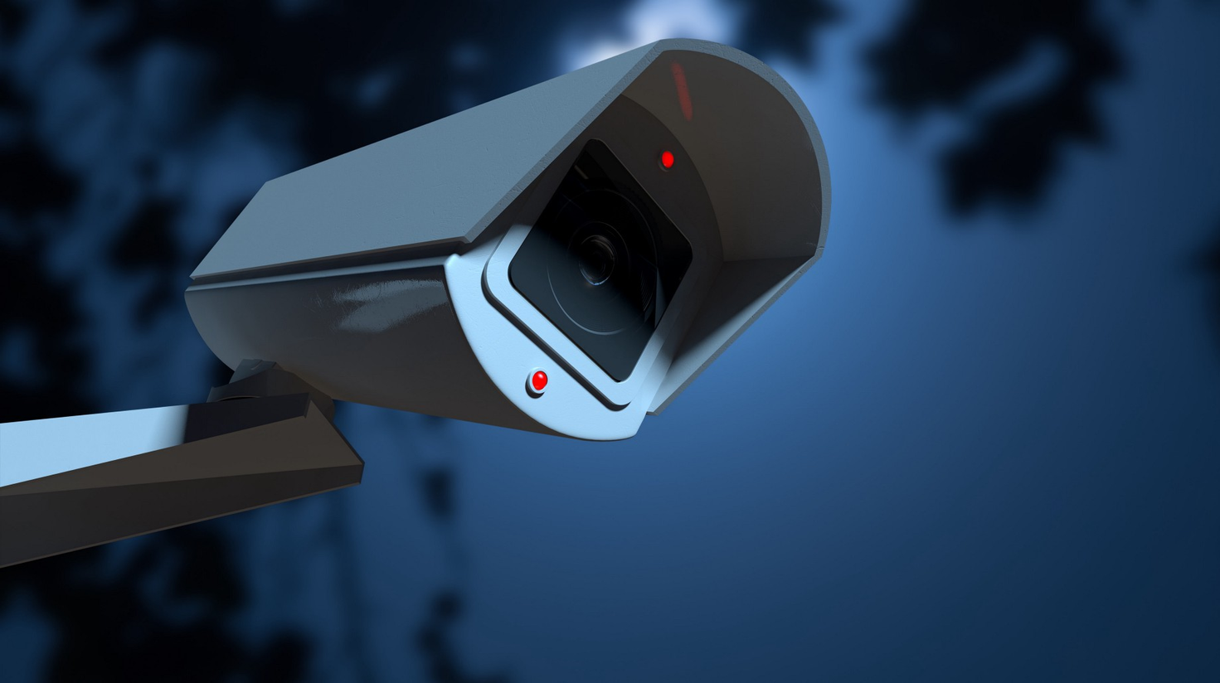
PROBLEM STATEMENT
The objective of this project is to develop a robust AI system that can automatically monitor CCTV camera feeds and generate real-time descriptive captions for observed activities. Traditional CCTV monitoring depends heavily on human operators, leading to issues such as fatigue, inconsistency, and delayed responses. By leveraging AI and deep learning, we aim to enhance security, improve incident response times, and reduce operational costs. Key challenges include accurately recognizing and describing diverse activities in various environments, ensuring real-time processing with minimal latency, scaling the solution to handle multiple camera feeds simultaneously, and maintaining high accuracy to avoid false alarms and missed detections.
01

Slide 4
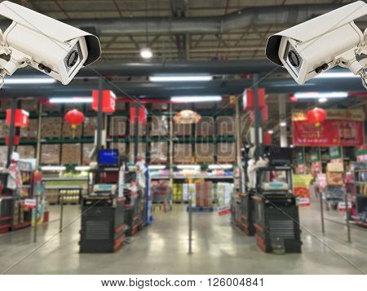
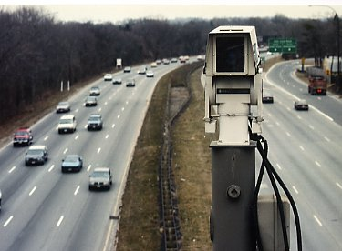
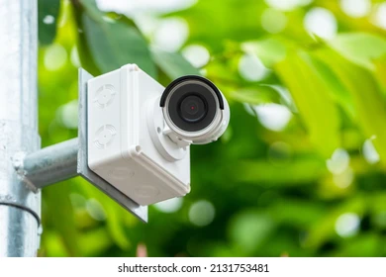
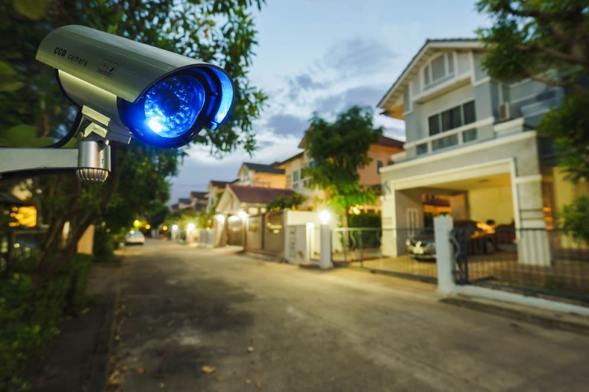
Enhanced Security Monitoring: Automate the surveillance process by generating real-time captions for activities detected by CCTV cameras. This reduces the reliance on human operators, minimizing the risk of missed incidents.
Incident Detection and Alerting: Quickly identify and describe unusual activities or potential threats, triggering instant alerts to security personnel for faster response times.
Traffic Management: Monitor traffic patterns and detect accidents or unusual vehicle behaviors, helping to manage traffic flow and improve road safety.
Healthcare Security: Monitor patient and staff movements in hospitals and healthcare facilities to ensure safety, identify unauthorized access, and manage emergency situations effectively.
Retail Analytics: Analyze customer behavior in retail environments, providing insights into store traffic, customer interactions, and potential security issues such as shoplifting.
BUSINESS USE CASES

Slide 5


DATASET & DATA PREPROCESSING
Dataset: Flickr8k Dataset (Link)
Description: Contains 8,000 images each with five different captions.
Data Preprocessing:
Text Preprocessing:
Convert text to lower case
Remove links, new lines, words containing numbers, extra spaces, special characters
Remove stop words
Apply stemming and lemmatization
Image Preprocessing:
Resize images to a uniform size
Normalize pixel values
Apply data augmentation techniques (rotations, flips)
02

Slide 6
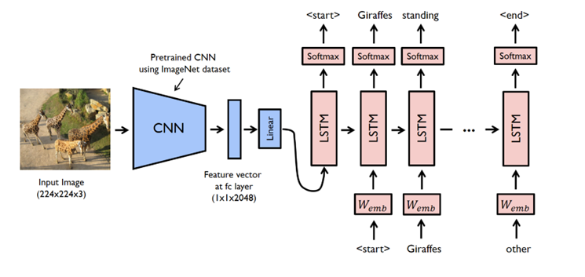

MODELING APPROACH
To develop our automated CCTV monitoring system using image captioning, we utilized the Flickr8k dataset from Kaggle, containing 8,000 images each with five different captions. The dataset was split into Training (70%), Testing (20%), and Validation (10%) sets to ensure comprehensive model evaluation. For preprocessing, images were resized to a uniform size, pixel values were normalized, and data augmentation techniques such as rotations and flips were applied to enhance model robustness. Text preprocessing involved converting text to lower case, removing links, new lines, words containing numbers, extra spaces, and special characters, removing stop words, and applying stemming and lemmatization. Captions were tokenized into words, a vocabulary was built, and words were converted to numerical indices. We built three models: CNN + RNN, where CNN extracts image features and RNN generates captions; CNN + LSTM, where LSTM handles long-term dependencies in caption generation; and pre-trained models like VGG, ResNet, and EfficientNet for advanced feature extraction. Each model was trained on the training set and evaluated on the test set using metrics such as BLEU, METEOR, CIDEr, and ROUGE. The best-performing model was then validated on the validation set, and fine-tuning was performed to optimize performance, with final metrics reported on the validation set.
02
03

Slide 7
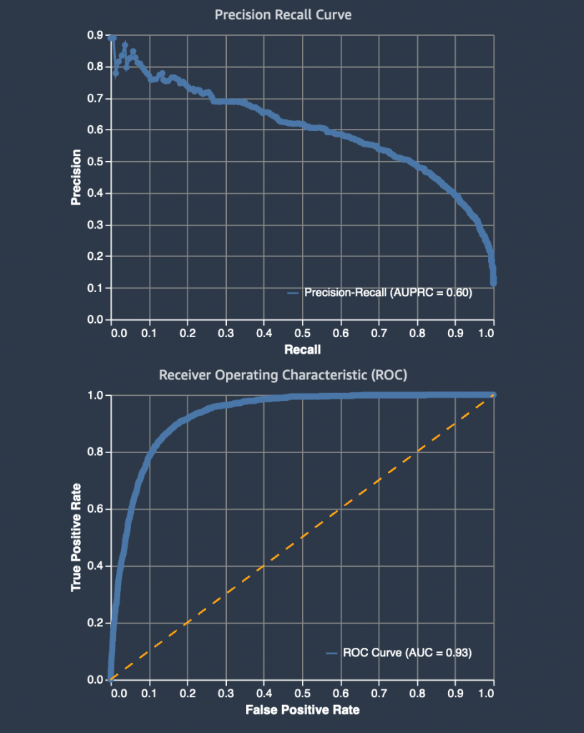
MODEL EVALUATION METRICS AND RESULTS
To evaluate our image captioning models, we employed several key metrics: BLEU (measures the precision of n-grams in generated captions compared to references), METEOR (assesses precision, recall, and linguistic variations), CIDEr (evaluates the consensus of generated captions with multiple human references), and ROUGE (focuses on recall and overlap of n-grams). The CNN + RNN model achieved decent performance on both training and test sets, while the CNN + LSTM model showed improved handling of long-term dependencies. However, the pre-trained models (VGG, ResNet, EfficientNet) excelled across all metrics, particularly in BLEU, METEOR, CIDEr, and ROUGE scores, indicating their superior feature extraction capabilities. The pre-trained model (e.g., EfficientNet) emerged as the best performer, demonstrating high accuracy and consistency in generating captions, making it the optimal choice for real-time CCTV monitoring applications.

Slide 8
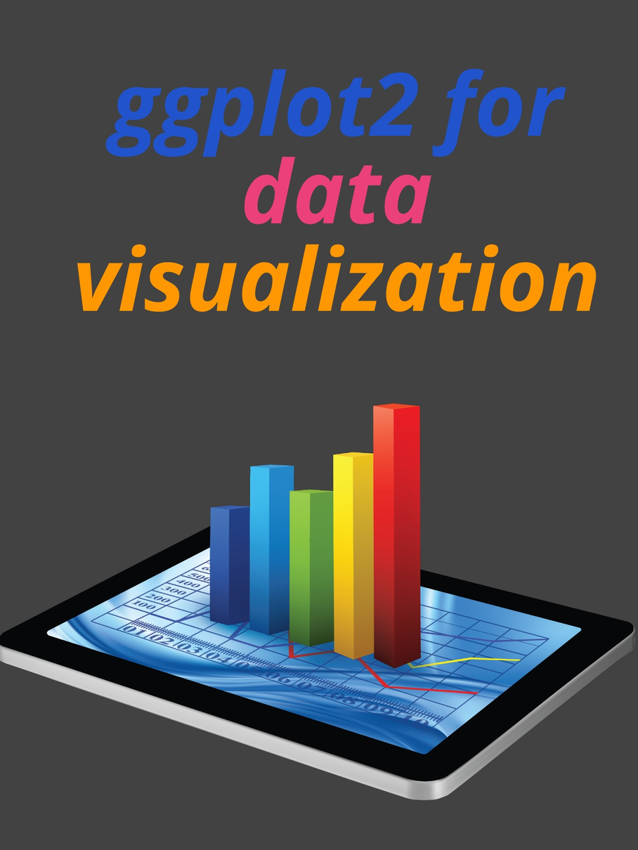
DATA VISUALIZATION
In the data visualization section, we present a range of visualizations to illustrate the performance and functionality of our automated CCTV monitoring system.
Key elements include:
Input vs. Generated Captions: Display example images from the dataset alongside the captions generated by the model. This comparison highlights the model’s ability to accurately describe various activities and scenes captured by CCTV cameras.
Performance Metrics Plots: Provide visualizations of key evaluation metrics (BLEU, METEOR, CIDER, ROUGE) for each model. Use bar charts or line graphs to compare the performance of CNN + RNN, CNN + LSTM, and pre-trained models, showcasing which model performs best across different metrics.
Confusion Matrix: Show a confusion matrix for the most accurate model to visualize common errors and the types of activities that are correctly or incorrectly captioned. This helps identify areas for improvement in model accuracy.
Caption Quality Analysis: Present plots or word clouds generated from the most frequent and least frequent words in the captions, providing insight into the model’s descriptive capabilities and common themes in generated captions.
Real-time Example: Include a short video or series of snapshots demonstrating the model in action, with real-time captions being generated for live CCTV footage. This helps to visualize the practical application of the model in a real-world scenario.

Slide 9

FUTURE SCOPE
The future scope of our automated CCTV monitoring system includes several avenues for enhancement and expansion. To further improve system accuracy and applicability, we plan to explore the following directions:
Model Optimization: Investigate advanced neural network architectures and techniques such as Transformer models or attention mechanisms to enhance captioning accuracy and context understanding.
Diverse Datasets: Incorporate additional and more varied datasets to train the model, capturing a broader range of activities, environments, and scenarios to improve generalization and robustness.
Real-time Integration: Develop capabilities for real-time caption generation and processing to ensure immediate responses and alerts, essential for live surveillance and security applications.
Contextual Awareness: Enhance the model’s ability to understand and describe complex interactions and contextual details by integrating multi-modal data sources, such as audio and sensor data.
User Feedback Mechanism: Implement a feedback loop where security personnel can provide input on caption accuracy, allowing the system to learn and adapt based on real-world use and feedback.
Scalability: Scale the system to manage multiple camera feeds simultaneously across large facilities or city-wide surveillance networks, ensuring efficient monitoring and data processing.
Cross-domain Applications: Explore applications beyond CCTV monitoring, such as automated content description for media, accessibility improvements for visually impaired users, and real-time analytics for various industries.

Slide 10

CONCLUSION
In summary, our project successfully developed an advanced automated CCTV monitoring system utilizing image captioning through AI and deep learning techniques. By leveraging the Flickr8k dataset and implementing models such as CNN + RNN, CNN + LSTM, and pre-trained architectures (VGG, ResNet, EfficientNet), we achieved significant improvements in real-time activity recognition and description. Our evaluation metrics—BLEU, METEOR, CIDEr, and ROUGE—demonstrated that the pre-trained models, particularly EfficientNet, provided superior performance in generating accurate and contextually relevant captions. This advancement addresses critical challenges in traditional CCTV monitoring, including operator fatigue, delayed responses, and scalability issues. The system not only enhances security and operational efficiency but also opens avenues for further innovation, such as real-time processing, integration of multi-modal data, and scalability across extensive networks. Moving forward, continued refinement and expansion will further solidify the system’s role in modern surveillance and extend its benefits to a wider range of applications.

Slide 11
THANK YOU

